Slide 1
Data Science Unit 1
Introduction to Data Science

Slide 2
Before we start...
Make sure you are comfortable Have water and maybe a strong coffee handy If you need a break...take it! If you need a stretch - please go ahead! Please mute yourselves if you are not talking Have your video on at all times
...and let’s get started!

Slide 3
In this session we will...
Understand what data science is and who a data scientist is Understand the differences between classical programming and machine learning Discuss the types of machine learning Understand algorithms and algorithm training Familiarise yourself with machine learning terms and definitions

Slide 4
What is a Data Scientist?
Notes:
Before we begin we should ask ourselves the question, what is data science? Does anyone have any ideas?

Slide 5
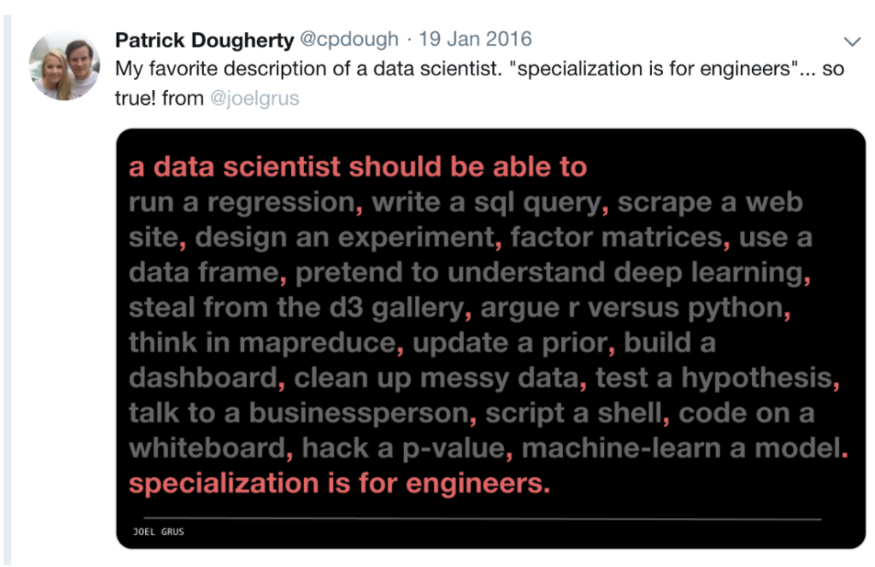
Notes:
A data analyst is a subset of a data scientist, so while you are working with data you can consider yourself as one. There are many skills you will need, most of which you will be shown throughout this bootcamp.

Slide 6
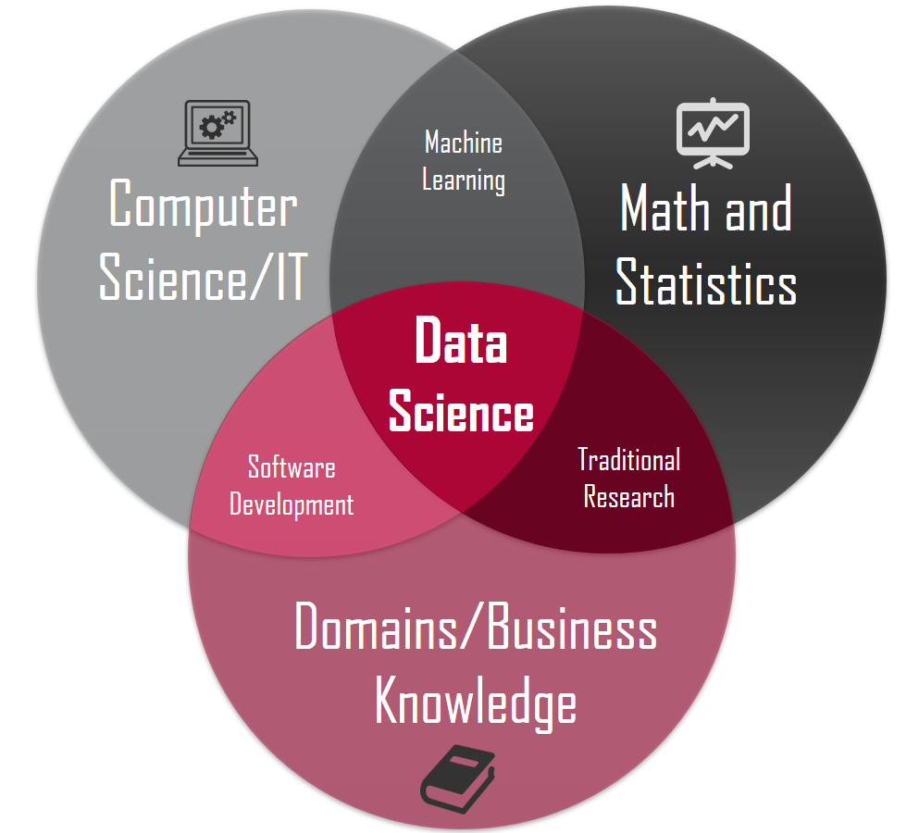
Intro to Data Science
Notes:
Another way to think of data science is that it is the intersection of maths, business and computer science. To be successful in this field you will need to be able to demonstrate all 3.

Slide 7
Activity
Give an example of a product or service you think utilises data science
Notes:
In break out rooms (5 minutes) discuss and feedback any products or services you know that make use of data science

Slide 8
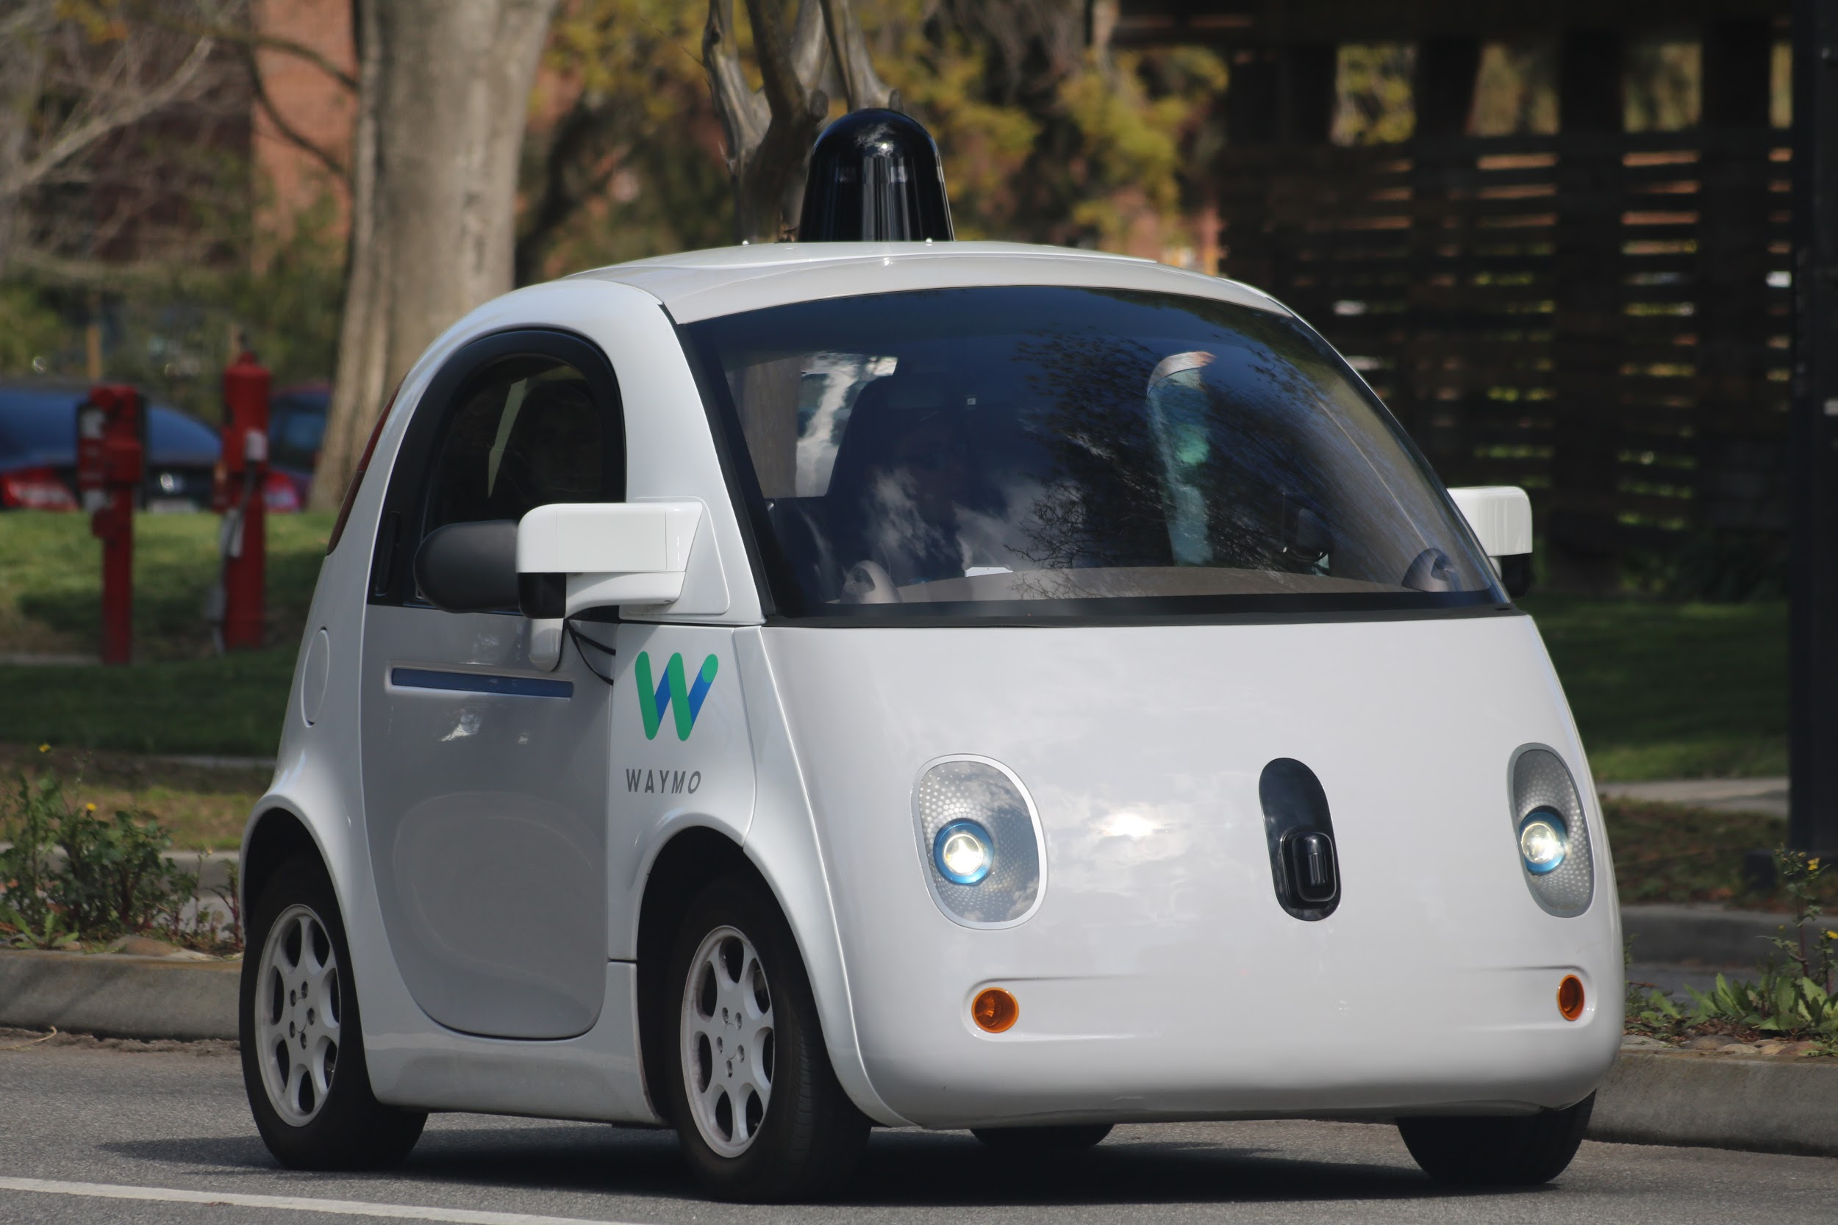

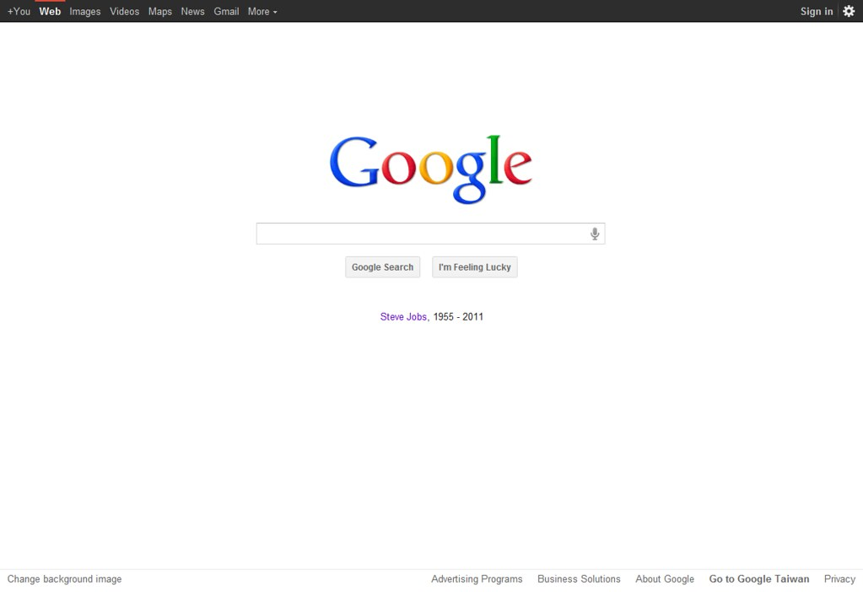


Intro to Data Science
Notes:
Here’s some examples I came up with:
Providing movie recommendations on Netflix.
Making product suggestions on Amazon.
Developing self-driving cars
Trading stocks on the stock-market at high frequency
Returning auto-translate and search results on Google

Slide 9
Data Science Workflow
Notes:
Now we have established what a data scientist is, let’s look again at how we set up a project (think back to M1)

Slide 10
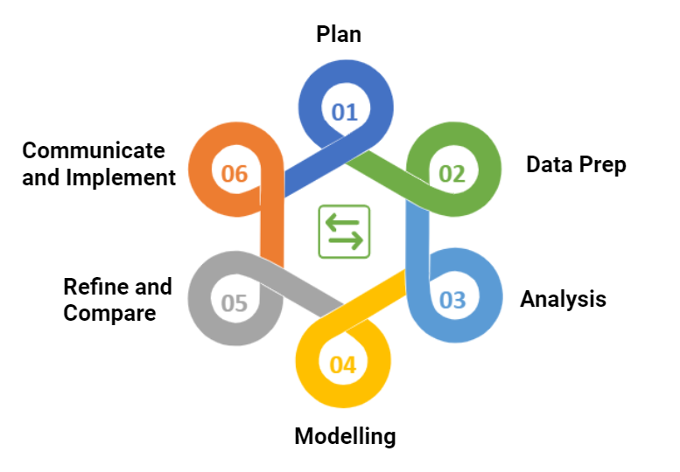
Recall the Data Analytics Lifecycle
Data Science Workflow
Notes:
A data scientist will follow all the steps from the analytics cycle we discussed back in M1, from collecting and cleaning the data, to analysing and modelling and finally presenting outcomes to relevant stakeholders. Keep in mind that not all projects will follow these steps in this order, it is perfectly normal to go back to a previous stage (for example, you’ve built a model but realised a further data cleaning step is necessary).

Slide 11

Activity
Business Scenario
You work for a real estate company interested in using data science to determine the best properties to buy and resell. Specifically, your company would like to identify the characteristics of residential houses that estimate their sale price and the cost-effectiveness of doing renovations. Using the analytics life cycle, describe the activities that you would carry out in each stage.
10 minutes

Slide 12
Plan
Identify the business/product objectives.
The customer tells us their business goals are to accurately predict prices for houses (so that they can sell them for as large a profit as possible) and to identify which kinds of features in the housing market would be more likely to lead to foreclosure and other abnormal sales (which could represent more profitable sales for the company).
Identify and hypothesise goals and criteria for success.
Deliver a presentation to the real estate team.
Write a business report discussing results, procedures used, and rationales.
Build an API that provides estimated returns.
Create a set of questions to help you identify the correct data set.
Can you think of questions that would help this customer deliver on their business goals?
What sort of features or columns would you want to see in the data?
Notes:
Oftentimes, we'll start by identifying the ideal data we would want for a project.
Then, during the data acquisition phase, we'll learn about the limitations on the types of data actually available. We have to decide if these limitations will inhibit our ability to answer our question of interest or if we can work with what we have to find a reasonable and reliable answer.
This is possibly the hardest step in the data science workflow. At this stage, it's common to realize that the problem you're trying to solve may not be solvable with the information available. The data could be incomplete, non-existant, or unable to meet the criteria necessary to answer your question.
That said, you now have a better feel for the data that's available and the information they could contain. You can now identify a new, answerable question that ultimately helps you solve or better understand your problem.

Slide 13
Data Prep
Common considerations when preparing our data include:
Ensuring data is clearly defined and structured
Check and clean data formatting as needed
Most data will not come perfectly clean and ready to use. Cleaning data is normally the most time-consuming task a data scientist faces.
Notes:
As you can see, the "Prepare" phase of the data science workflow encompasses several steps: the act of reviewing, indexing, and cleaning your data. This normally consumes a great deal of time!

Slide 14
Analyse
Data scientists often check for their data the:
Mean
Median
Standard deviation
Specific frequency counts
Distribution
Existence of Outliers
Notes:
What sort of questions do these statistics allow us to answer about or data set?

Slide 15
Model
Look to predict a value we are interested in, for example:
House price (Regression)
Number of rooms (Classification)
Notes:
What are some other business goals we can support as data scientists for this realty company? What are some values we would like to guess?
We'll be spending much of our time in this course on data analysis and predictive modeling.

Slide 16
Refine and Compare
Develop Recommendations and Decisions
Did you reject or fail to reject your hypothesis?
What does this mean for your project?
What does this mean for your client?
Were your questions answered?
Which ones?
What do you need to do to answer the ones that weren't?
Do your findings support any business recommendations, actions, or decisions?
Is there further supportive analysis?
How do your data support these recommendations?

Slide 17
Communicate and Implement
Share the Results of Your Analysis
Reaching a conclusion:
Seek guidance/interaction with subject matter experts (SMEs).
If those are not available, check with the data — are you coming to reasonable conclusions and predictions given what you've seen?
Do the next steps that you envision have any dependencies or corollary steps?
What are some conclusions you can draw?
Conclusion: "Customers from large companies were twice as likely to place another order with Planet Express than customers from small companies."
Recommendation: "We should target more large companies to use our delivery service."
Conclusion: "Other than size of company, I found no significant evidence that any other feature affected the odds of customers reusing our delivery service."
Notes:
Presentations are a critical part of your analysis. It doesn't matter how brilliant your model is or how illuminating your findings are — without effective communication, your work will not be used.
When crafting a presentation, always consider your audience and make sure to practice your presentation beforehand. Consider the types of questions people might ask or — better yet — test your presentation on a few people and pay attention to their response. Clarify and refine your presentation accordingly.

Slide 18
Introduction to Machine Learning
Notes:
Before we get on to do some coding (!) we will need to define a few things about Machine Learning.

Slide 19
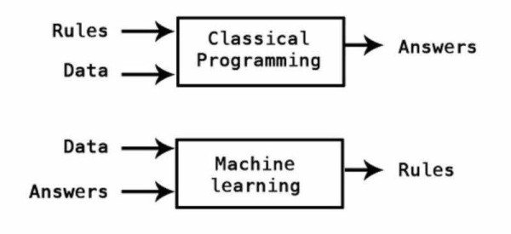
ML
Notes:
To explain how machine learning works, let’s first consider classical programming. In this case we supply the data and the rules, and the programme returns the solution.

Slide 20
ML
Rules:
Multiply data by 5
Add 7
Data:
[3, 4, 5]
Answer (computer generates answers based on rules and data)
[22, 27, 32]
Notes:
For example, we set an algorithm multiply by 5 then add 7. When we give the data to the algorithm it will give us the solutions, following the algorithm.

Slide 21
ML
Answers
[22, 27, 32]
Data:
[3, 4, 5]
Answer (computer generates rules based on data and answers)
Data * 5 + 7
Notes:
Machine learning on the other hand works the opposite way. We feed the model the data and the solutions and the model will tell us the algorithm. Moving this into real world examples- we could build a model predicting house price based off features such as location, number of bedrooms, size, etc. We would feed into the model houses we already know the price for, as well as the predictive features, and the model will try and find a relationship between them. We can then use this output to predict future house prices.

Slide 22
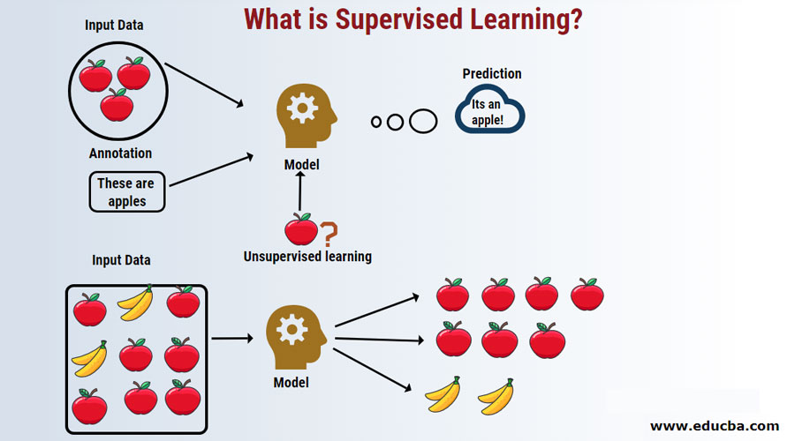
Categories of ML
Supervised Learning
Unsupervised Learning
Notes:
So now we know what machine learning is, it is important to understand there are two types. Supervised and unsupervised. For this bootcamp we will only be focussing on supervised learning, but there will be an opportunity for you to learn about unsupervised learning after DS4.

Slide 23
Supervised Learning
“The model is provided with both data (FEATURES) and the answers (TARGET). To put it simply, train the model using LABELLED data.”
Notes:
Essentially, supervised learning works by providing a model a target and a set of predictors (e.g. properties of a house to predict its price). The model will then use this data to find a pattern which we can use for prediction.

Slide 24
Types of Supervised
ML
Regression: The outcome to predict is a continuous value.
Classification: The outcome we are trying to predict is categorical.
Notes:
There are two types of supervised model- regression and classification. In regression the model is trying to predict a continuous value (house price, number of users, etc) while a classification model is trying to predict a categorical label (colour, blood type, etc). We will be learning about both methods in DS3.

Slide 25
Unsupervised Learning
“The model is provided with only data (FEATURES) and it learns the interactions in the features, creating groups (CLUSTERS) in the process”
Notes:
Unsupervised learning on the other hand looks to group data together into clusters. For example, trying to identify the best location to place a well. If you know information (features) about the soil over a large area, you can use an unsupervised model to try and predict where the most likely places water will be. As I said, unsupervised models are not part of our teaching curriculum, but there will be an opportunity for you to study them in your own time.

Slide 26
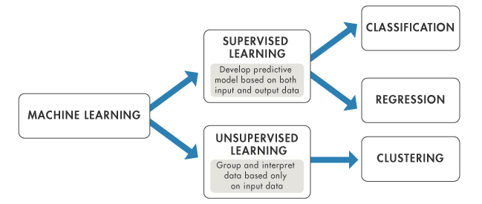
Machine Learning
Notes:
To summarise then, machine learning can be broken down into two paths: supervised and unsupervised. We will only be looking at supervised models in this course.

Slide 27
Activity

Slide 28
Activity
Open the folder ‘Ames_housing’- there is a dataset called “ames.csv” and a file called “description.txt”
Your task is to have look at the data and sketch out answers for the following
What is a potential target in your data for a regression model?
What is a potential target in your data for a classification model?
(Extend) Could unsupervised learning be used within this data? How so?
10 minutes

Slide 29
Algorithms
Notes:
Regardless of whether it's supervised or unsupervised, the underlying engine driving a machine learning model is an algorithm. These algorithms are used to help identify trends, represent said trends, and explain the overall variance of the data.

Slide 30
Algorithms
“An algorithm is a sequence of steps (rules) to solve a problem. They must be finite and solve the problem”
Notes:
Algorithms allow us to solve problems by following sequence of steps to reach the solution. It needs not be logical or mathematical. It is the way computers are able to solve problems. When we writ rules for a computer to solve problems, we are writing algorithms. The example we gave earlier for classical programming is an algorithm.

Slide 31


Algorithm
Algorithm:
Multiply data by 5
Add 7
Equation:
Answer = 5 * data + 7
y = mx + c
Notes:
This is a simple straight line equation. But if input that formula into the computer, it throws an error because it is not written algorithmically. However, to make the computer solve problems using that equation, we use the rules on the left. Understanding algorithm would be essential for your coding journey.

Slide 32
Activity

Slide 33
Activity
Let's say we are a real estate agent looking to price a house using only its square footage. We know there are other features that can highly influence this outcome, but we are only focusing on square footage for now. We know that, as square footage increases, so does price.
Recently, we sold a house whose square footage was 2,500 for about £285,000 and an additional £10,000 for stamp duties. Based on this information:
Generate an equation for house price using the square footage and stamp duties
Generate an algorithm for a computer to compute price of a house given this information
10 minutes
Notes:
Answer:
Price = 114*sq_footage + 10000

Slide 34
Activity

Slide 35
Activity
In breakout rooms, think about a use case (if any) or potential use case of ML in your organization
What type of ML would it be (supervised or unsupervised). If supervised, is it going to be regression or classification.
What benefits does your organization gets with potential implementation of ML
10 minutes

